Slide 1
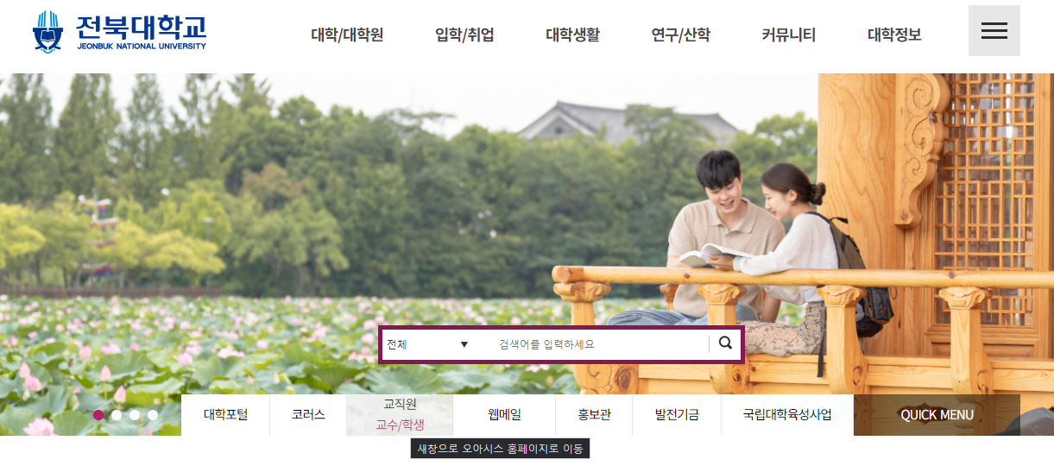
1. HOW TO FIND AND LOG IN ENGLISH VERSION OF OASIS
Connect to JBNU homepage. Then Click the button of this section.

Slide 2
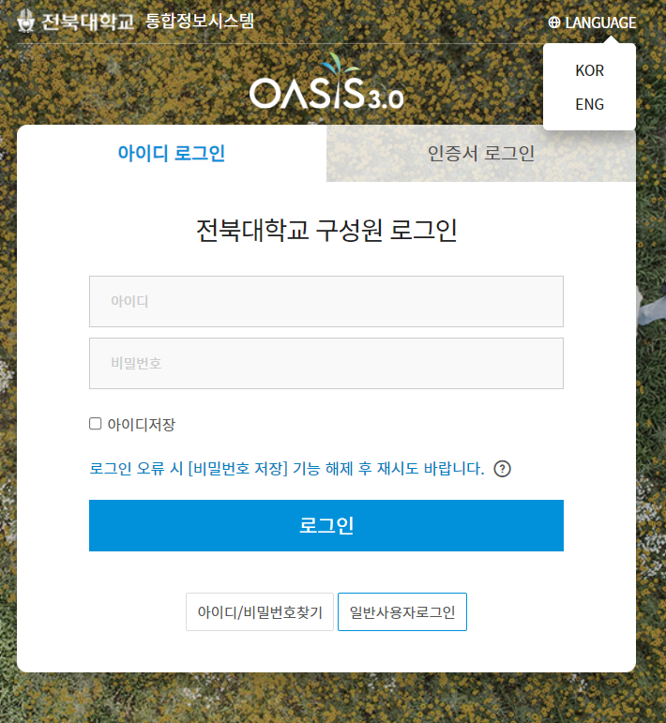
1. HOW TO FIND AND LOG IN ENGLISH VERSION OF OASIS
Before Logging in,
Click This Button for English version
2. Type your student ID and Password

Slide 3
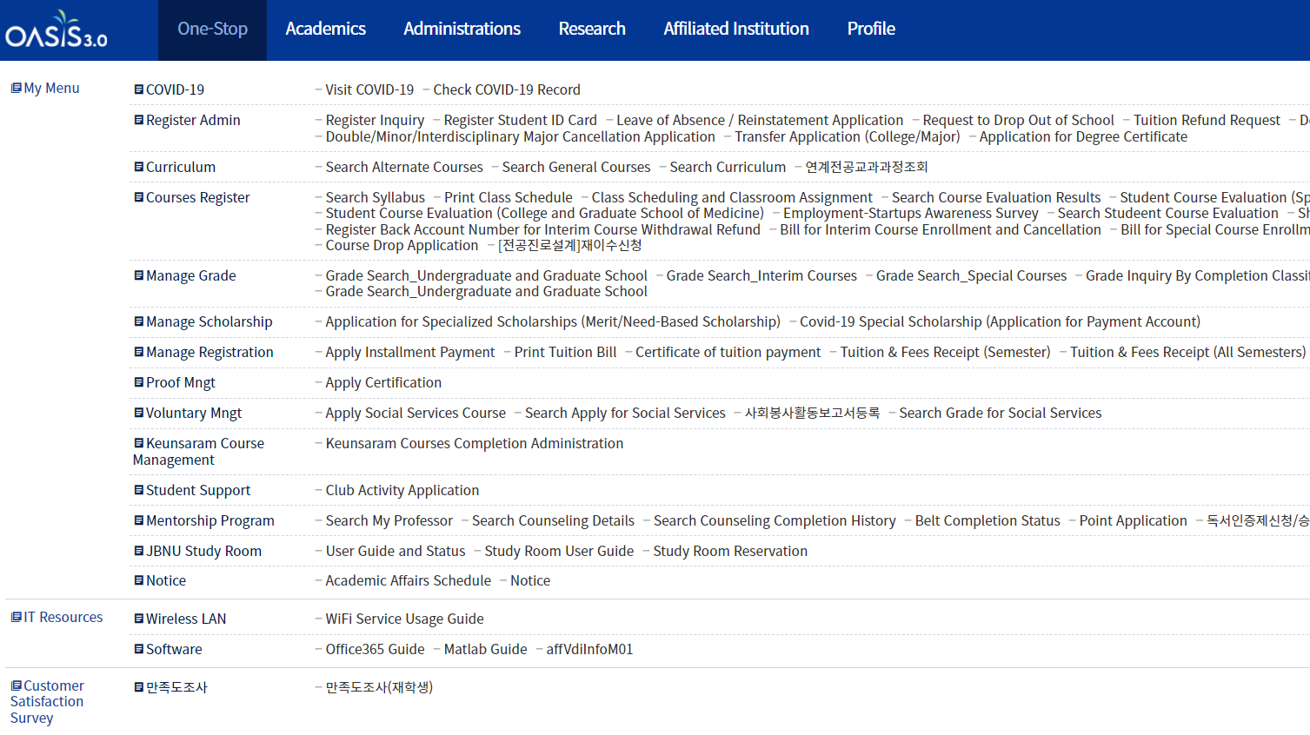
2. HOW TO RETAKE “MAJOR CAREER DESIGN”
(ENGLISH VER.)
1. Place the cursor over this button
2. Click this button

Slide 4
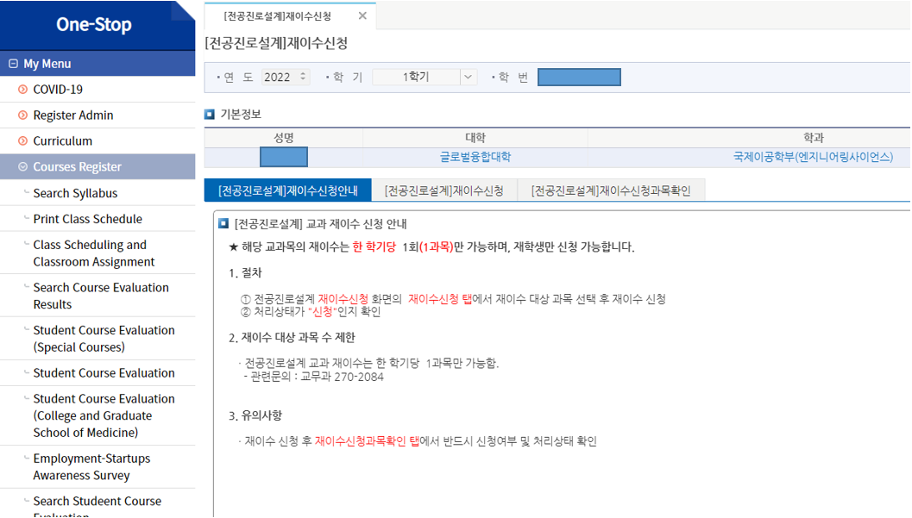
2. HOW TO RETAKE “MAJOR CAREER DESIGN”
(ENGLISH VER.)
Semester
3. Here, you can apply for a re-take of major career design.
Guidelines for Application for Re-take of Major Career Design Curriculum
★ Only once per semester (one subject) is allowed to re-take the subject, and only enrolled students can apply.
1. Procedures
Apply for re-take after selecting the subject to re-take from the 재이수신청 tab of the 재이수신청 screen
Check if the processing status is “신청”
2. Limit the number of subjects to retake
Only one subject per semester is allowed to re-take major career design courses.
Related inquiries: 교무과 270-2084
3. Precautions
After re-taking application, check the application status and processing status on the 재이수신청과목확인 tab

Slide 5
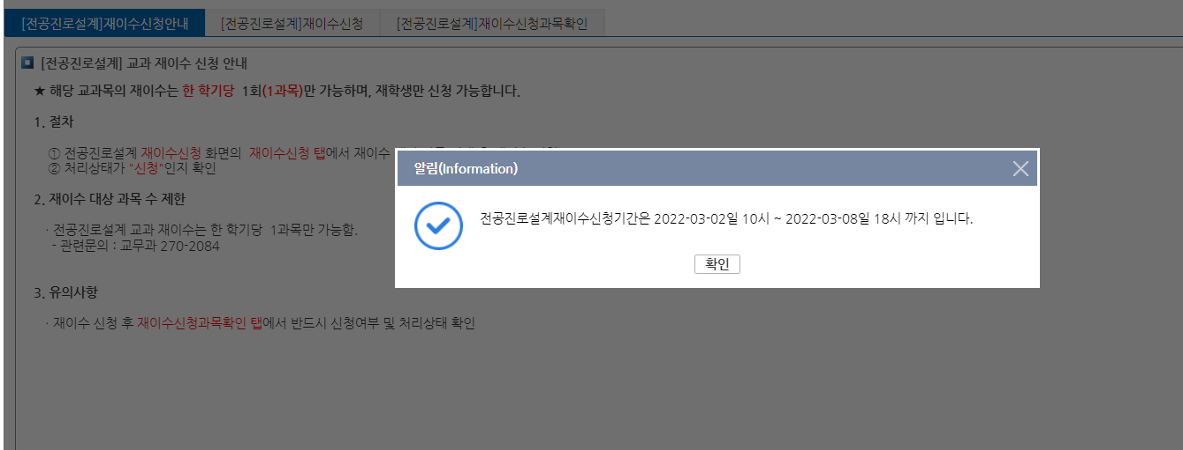
2. HOW TO RETAKE “MAJOR CAREER DESIGN”
(ENGLISH VER.)
When you click the application button when it is not the application period, a notification window appears like this.
The application period for the re-take of the major career design is from 10 o'clock on 2022-03-02 to 18 o'clock on 2022-03-08.

Slide 6
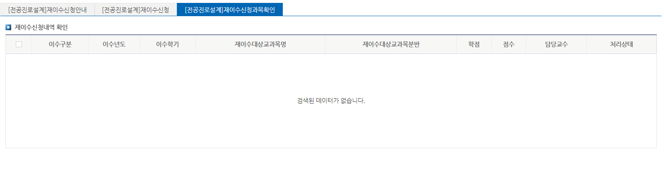
2. HOW TO RETAKE “MAJOR CAREER DESIGN”
(ENGLISH VER.)
4. Check application status and processing status
Confirmation of re-entry application subject
Confirmation of re-entry application details
year
semester
Subject Name
classification of subjects
credit
Score
Professor
Processing status

